Slide 1
RETAIL BANKING SYSTEM-POD2
PRESENTED BY,
KALYAN (896825)
SRIYA SUHRUDI(896881)
JYOTHIRLATHA(896875)
ALEKHYA(897020)

Slide 2
INTRODUCTION
Retail Banking System is a handy application for the bank employees and customers for performing the bank operations.
Our application is divided into five microservices which are authentication, customer ,account ,transaction ,rules and a UI portal.
Employee has the privilege of customer creation , account creation ,delete of customer account , view customer details.
The customer can perform operations such as withdrawal ,transfer and check the list of transactions performed.

Slide 3
PROJECT MICROSERVICES
Authentication Module
Account Management Module
Customer Module
Transactions Module
Rules Module
UI Portal(Bank MVC Microservice)

Slide 4
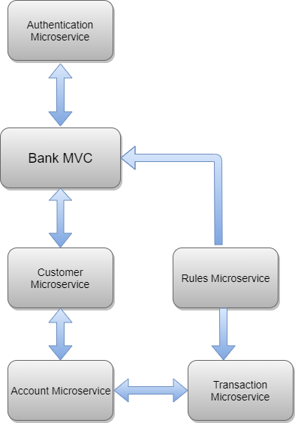
SYSTEM ARCHITECTURE

Slide 5
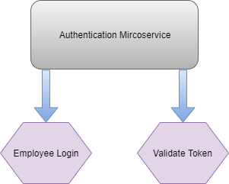
AUTHENTICATION MICROSERVICE
This microservice is responsible for authorizing privileges to the clients i.e., for the employee and the customer
Employee has the authority for customer creation, deletion and updation and also creation of accounts.
Customer can perform operations like withdraw, transfer ,checking the list of transactions.
Tokens are generated for the authorization.

Slide 6
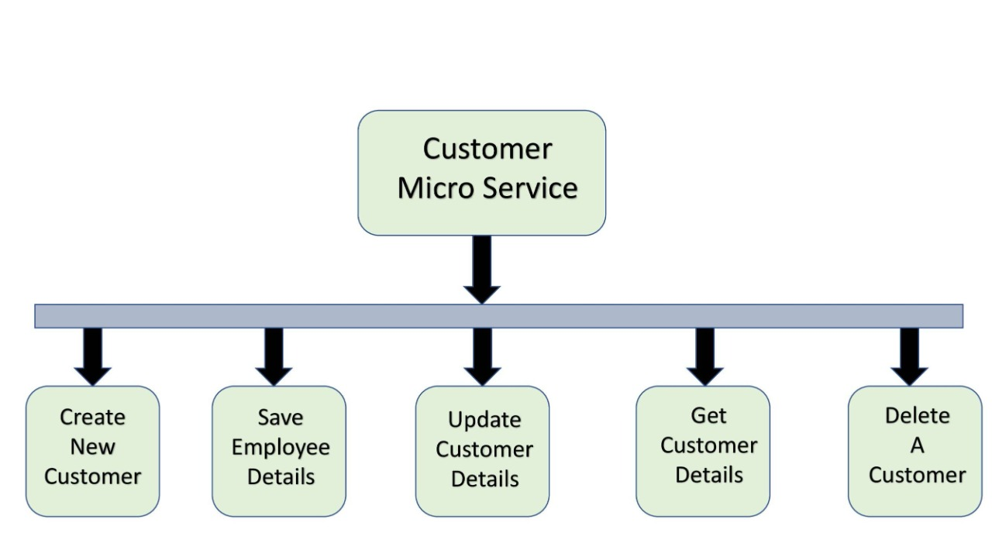
CUSTOMER MICROSERVICE

Slide 7
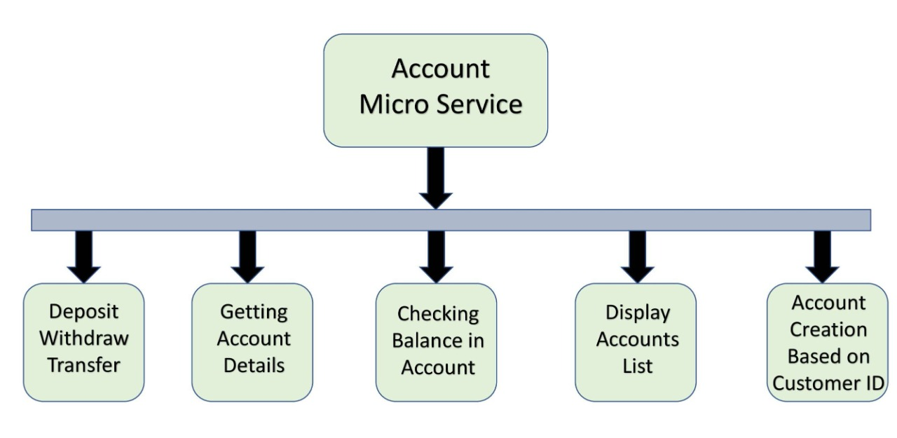
ACCOUNT MICROSERVICE

Slide 8
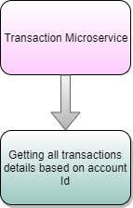
TRANSACTION MICROSERVICE
This microservice is responsible for performing operations like
Deposit
Withdraw
Transfer
Get Transactions
Minimum balance condition is checked for withdraw and transfer operation
Get Transaction operation returns the list of transactions performed in an account.

Slide 9
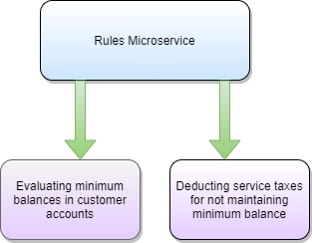
RULES MICROSERVICE
This microservice is responsible for evaluating the rules.
It evaluates the rule like maintaining the minimum balance while performing operations like withdraw and transfer.
It also imposes service charges for the customer accounts who doesn’t maintain the minimum balance.

Slide 10
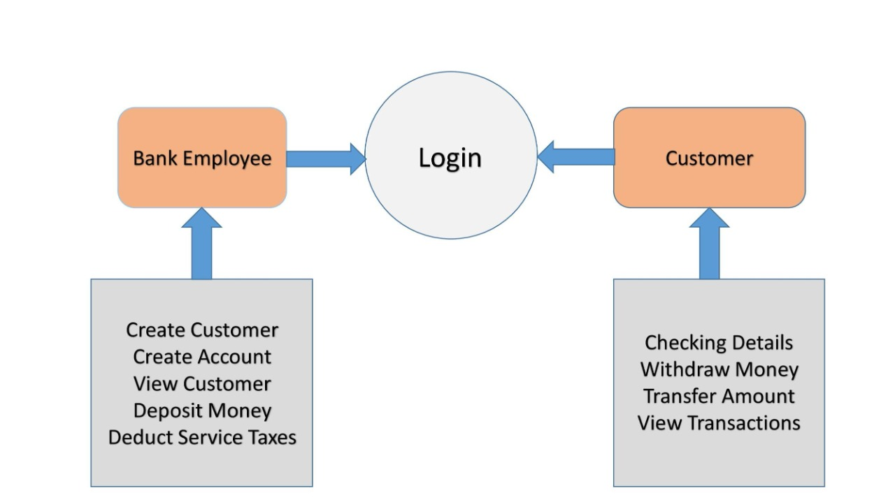
BANK MVC(UI PORTAL)

Slide 11
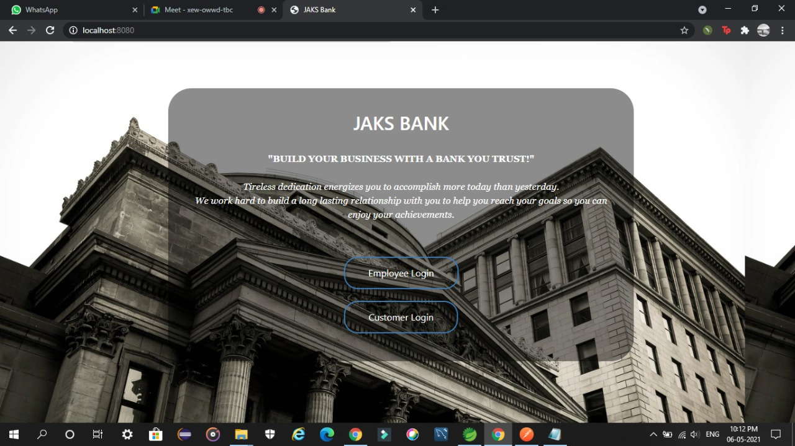
MAIN PAGE

Slide 12
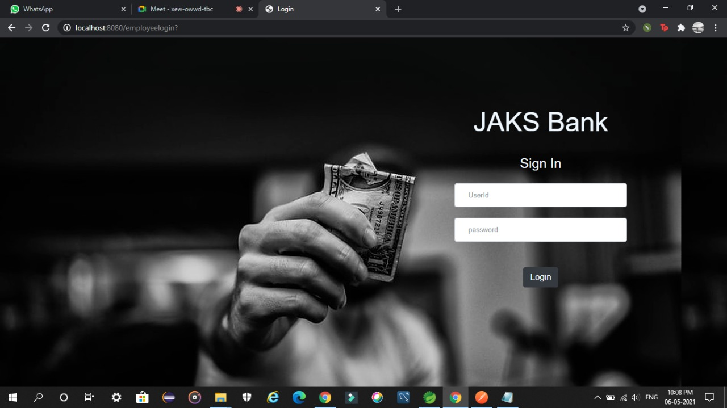
LOGIN PAGE

Slide 13
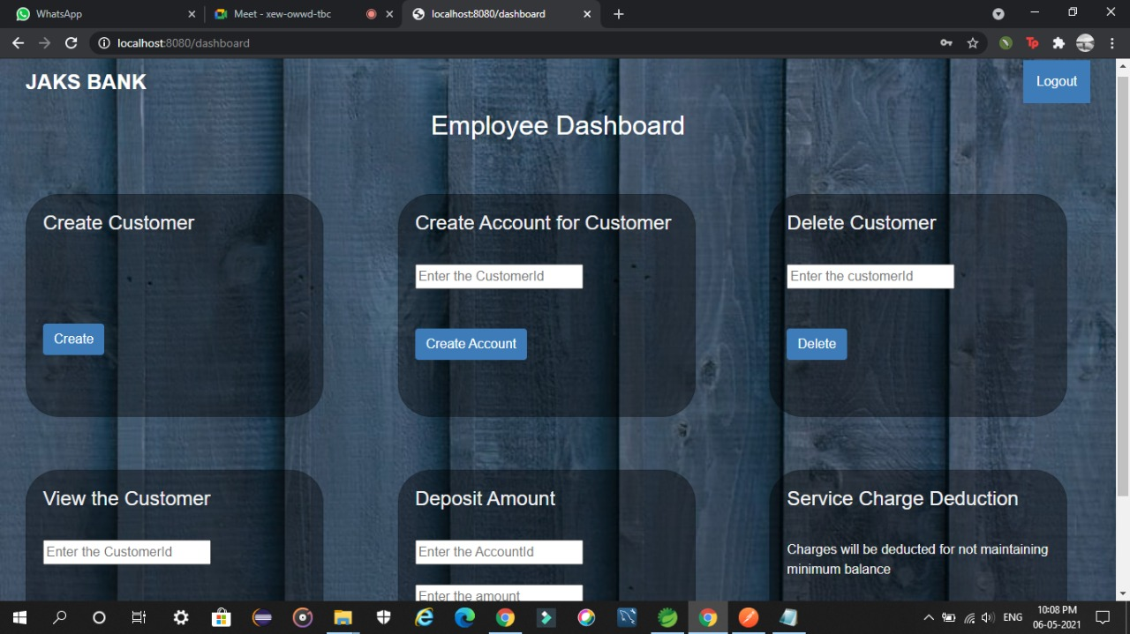
EMPLOYEE DASHBOARD

Slide 14
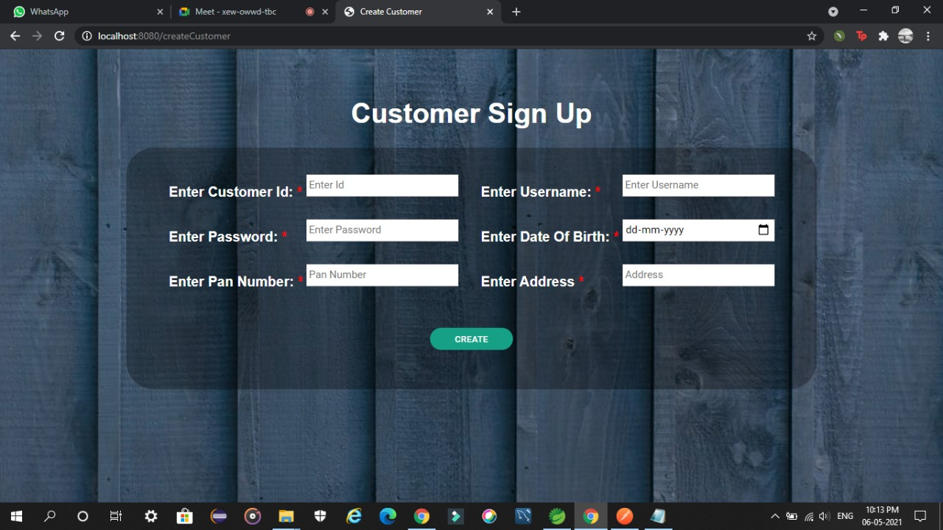
CUSTOMER SING IN

Slide 15
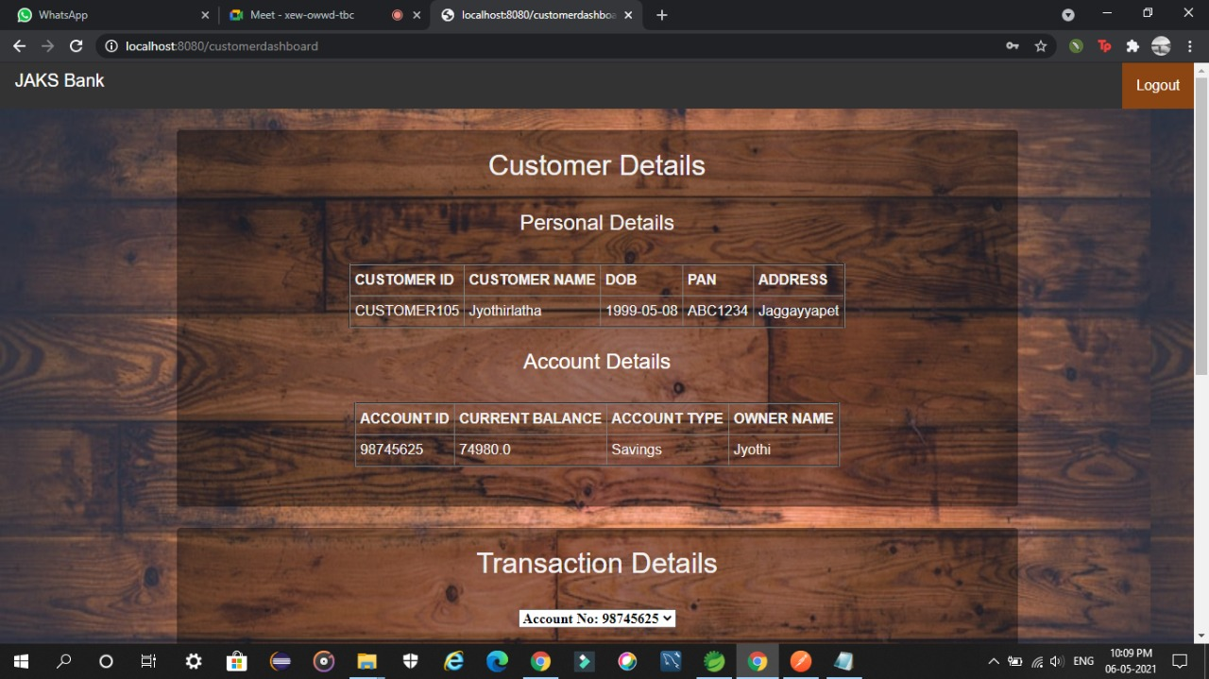
CUSTOMER DASHBOARD

Slide 16
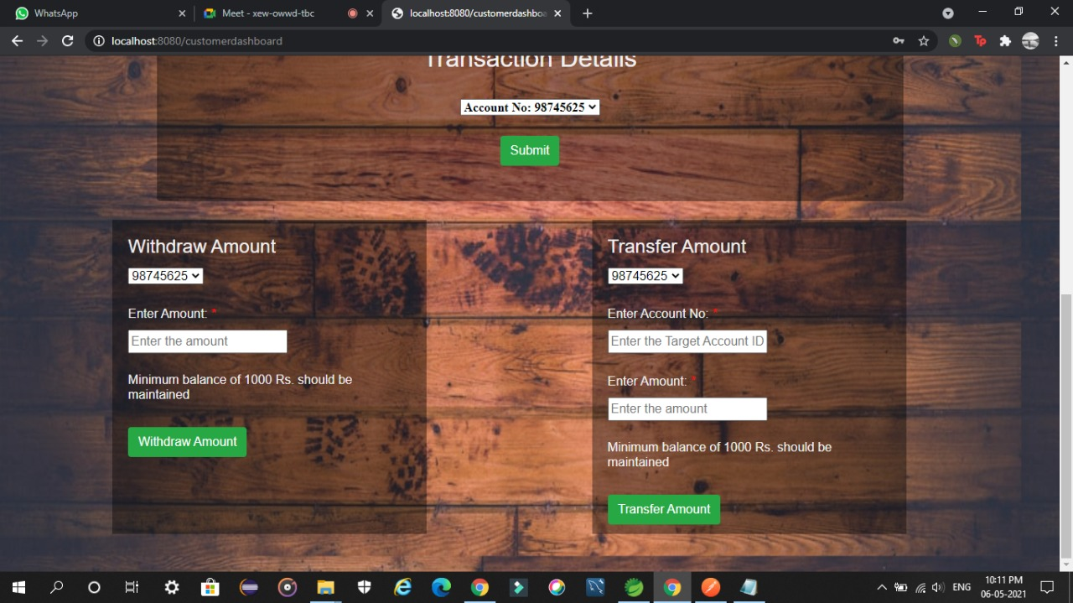
CUSTOMER DASHBOARD

Slide 17
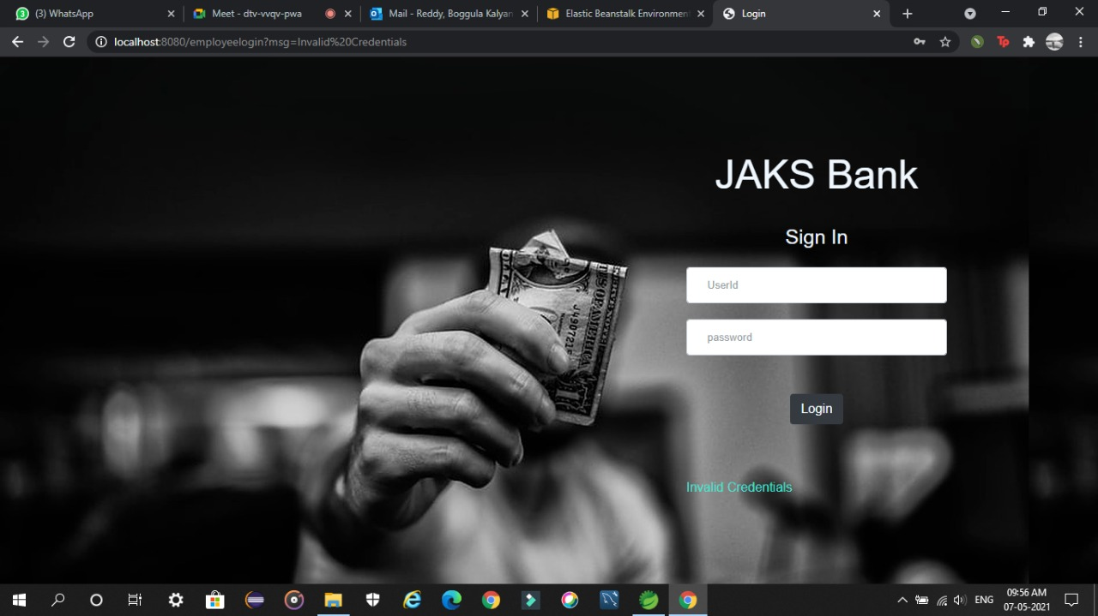
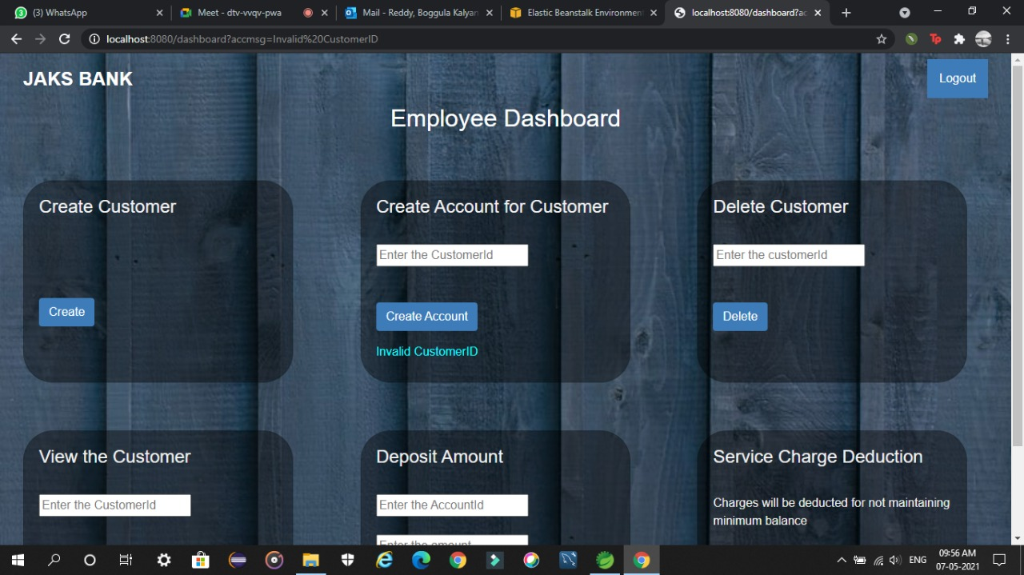

Slide 18


